Slide 1
Nonparametric Statistics in Criminology
An Examination of Crime Trends in New York City, Los Angeles, Chicago, Houston, and Detroit, and Their Relationships to the Size of Their Respective Police Forces

Slide 2
Background Police Information
In 2009, the number of total law enforcement employees was 1,021,456 operating in 14,614 different agencies in the United States
The 75 agencies in cities with over 250,000 people accounted for 206,064 of those employees. This means that slightly more than 1/5 of the law enforcement employees are in 0.513% of the agencies
There were 88,255 officers in the five cities of interest for this presentation. This means that over 8.6% (approximately 1/12) of the law enforcement employees are in these 5 cities.

Slide 3
Background Crime Information
In this presentation I will be focusing on the data for four particular varieties of crime: murder, rape, robbery, and assault.
The United States Department of Justice Bureau of Justice Statistics divides “violent crime” into 5 categories:
  Murder
  Forcible rape
  Robbery
  Aggravated Assault
  Simple Assault
Here are some charts showing the progression of these crimes from 2000-2010:

Slide 4
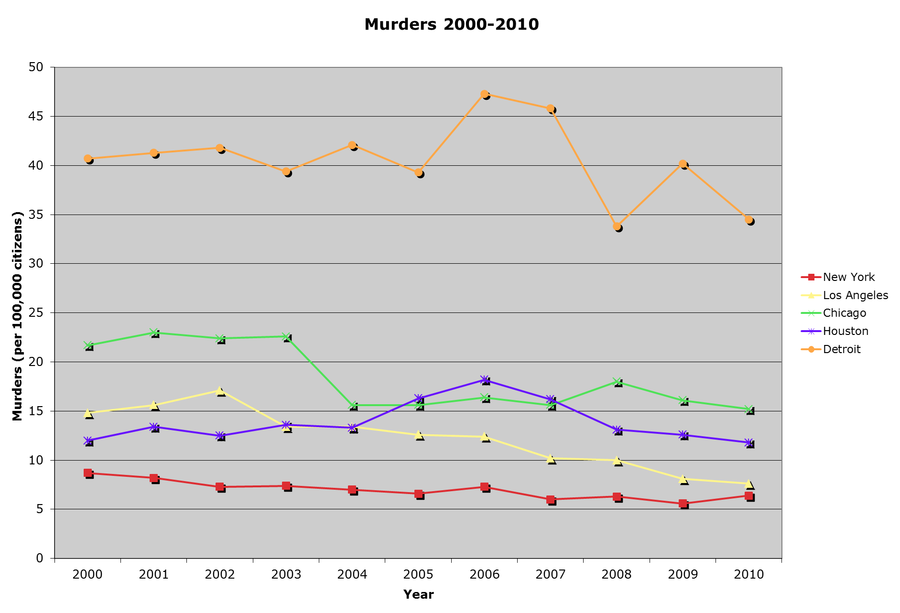

Slide 5
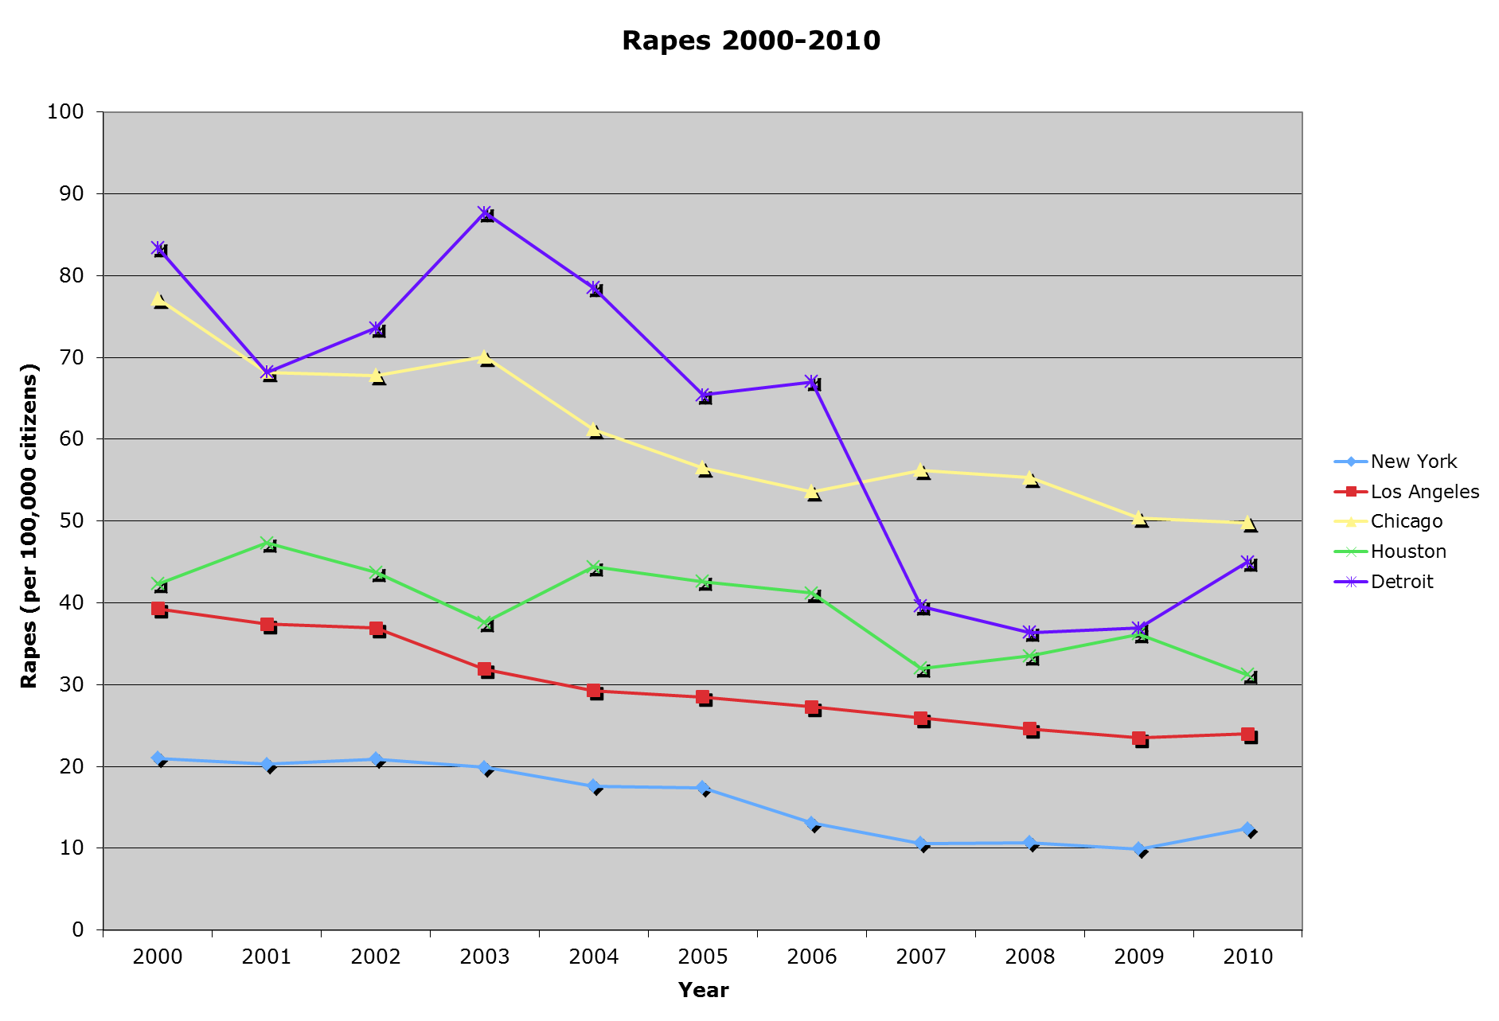

Slide 6
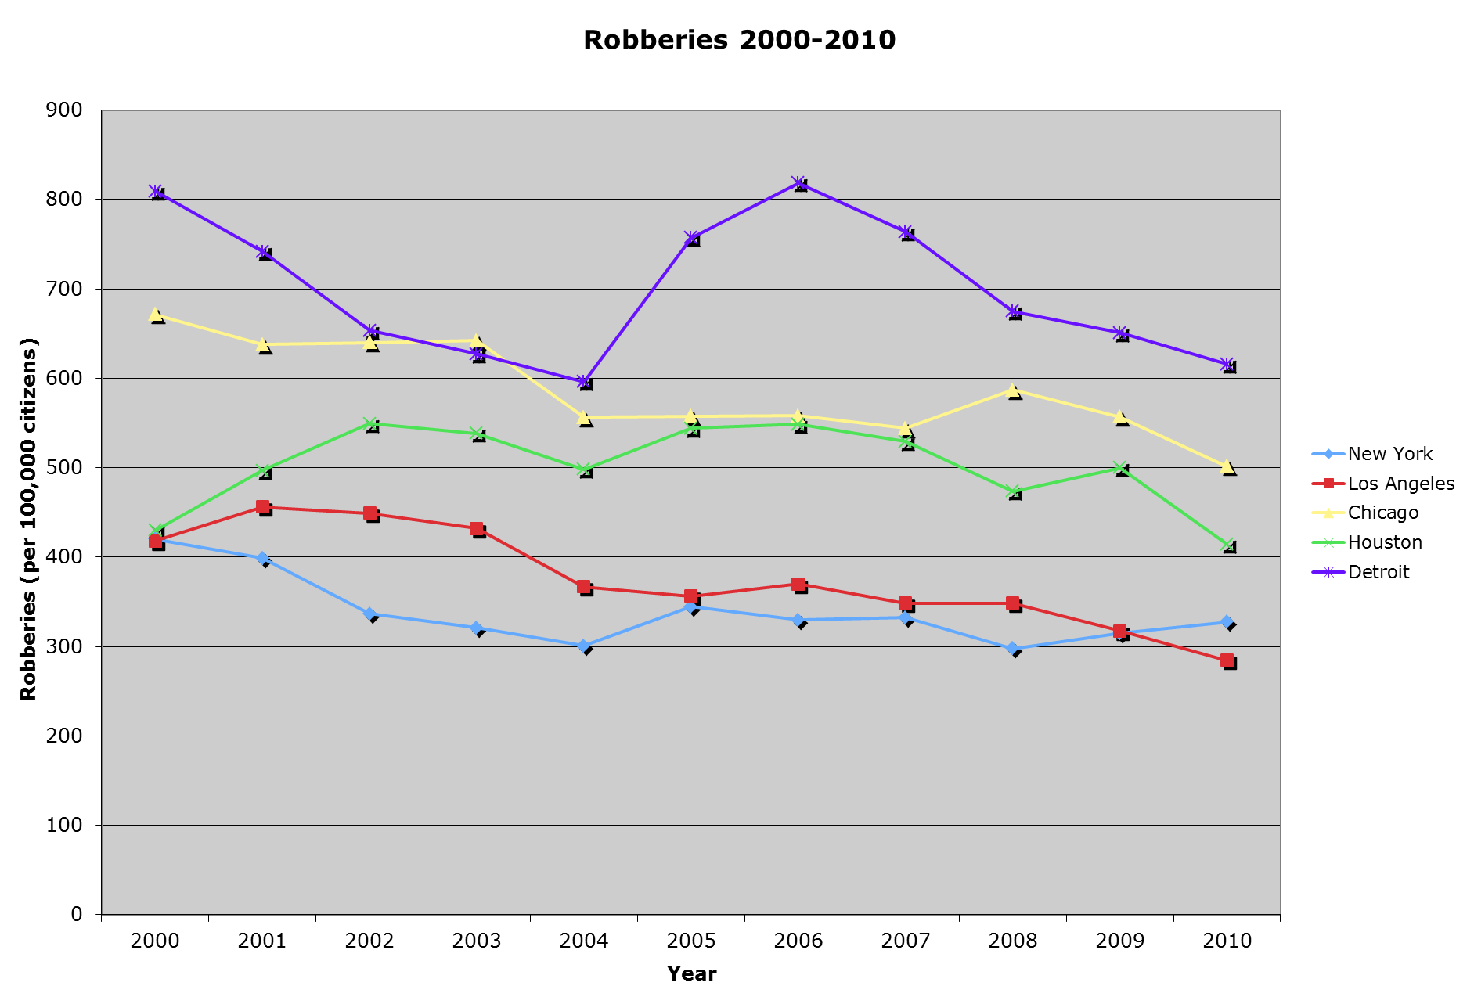

Slide 7
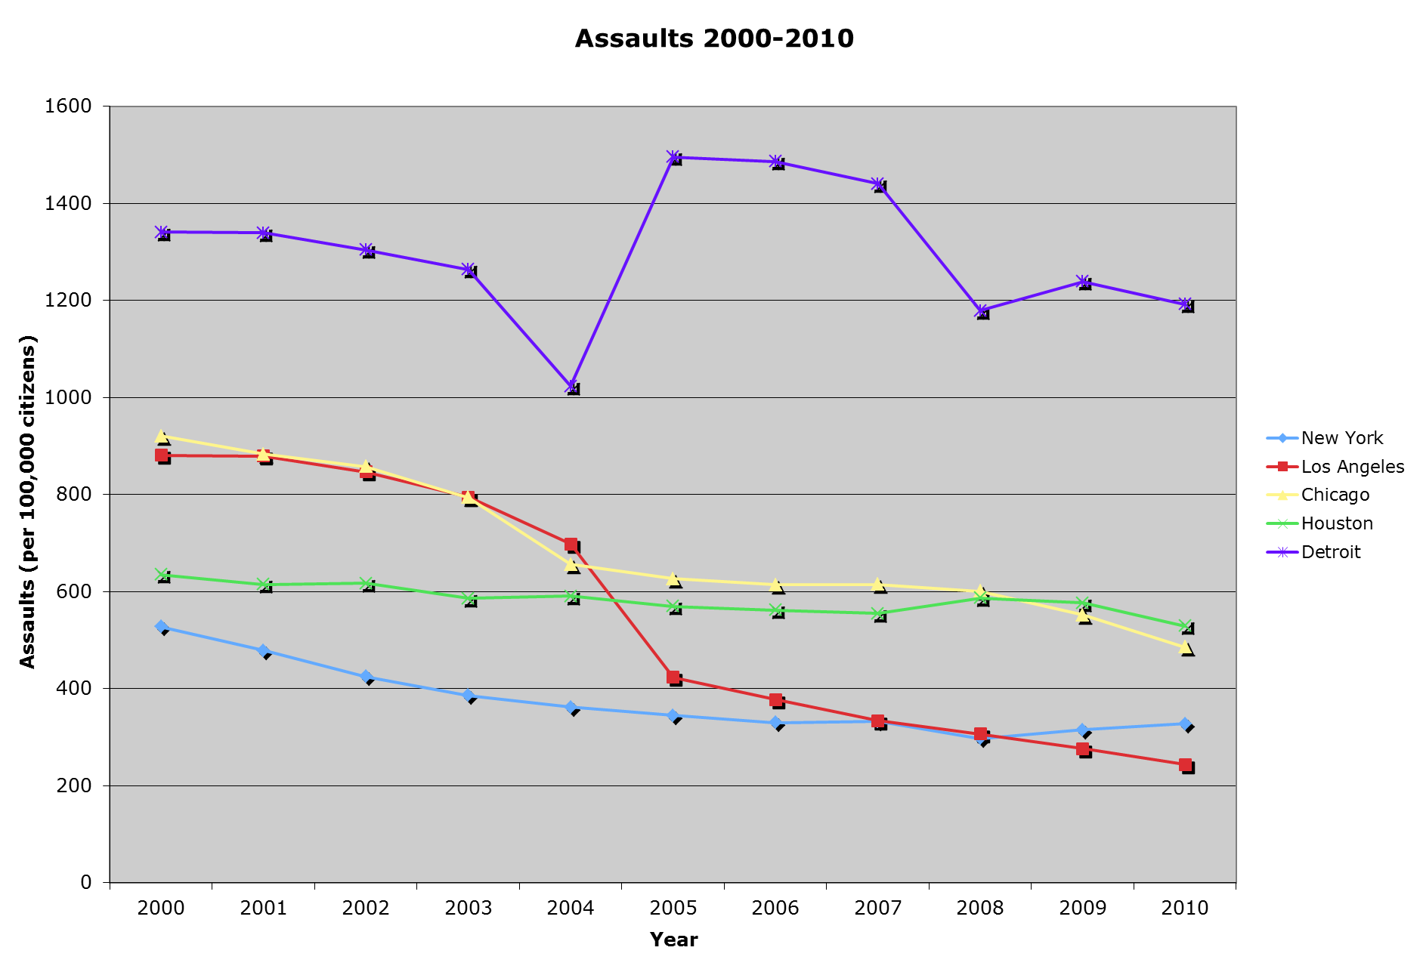

Slide 8
Does This Show a Clear Decrease?
I did not see clear, indisputable proof that there was a decrease in crime, but I certainly suspected there was
So next, I performed a distribution-free test for ordered alternatives in a randomized complete block design, also known as a Page test, to see if each type of crime was being reduced.
My response variable was number of crimes committed, my treatments were the different years, and my blocks were the different cities.
I ordered the treatments as such:
  2010=τ_{1 ,} 2009=τ_{2 …} 2000=τ₁₁
I also chose the alpha level to be 0.05

Slide 9
Page Test
H₀:τ₁= τ₂= …= τ₁₀= τ₁₁ vs. H₂: τ₁≤ τ₂≤ …≤ τ₁₀≤ τ₁₁ with at least one strict inequality
Murder: L=2297, L*≈4.082, p-value ≈0.000
Rape: L=2471, L*≈6.313, p-value ≈0.000
Robbery: L=2279, L*≈3.844, p-value ≈0.000
Assault: L=2424, L*≈5.708, p-value ≈0.000
I rejected all the null hypotheses in favor of the ordered alternative

Slide 10
What About the 5-0?
The next obvious question is, “Is crime reduced because of the police?”
Before delving into the relationship between crime statistics and the number of police, I decided to figure out if the number of cops has been increasing from 2000-2010
Here is a chart showing the number of law enforcement employees (proportional to the populations of the cities) over time:

Slide 11
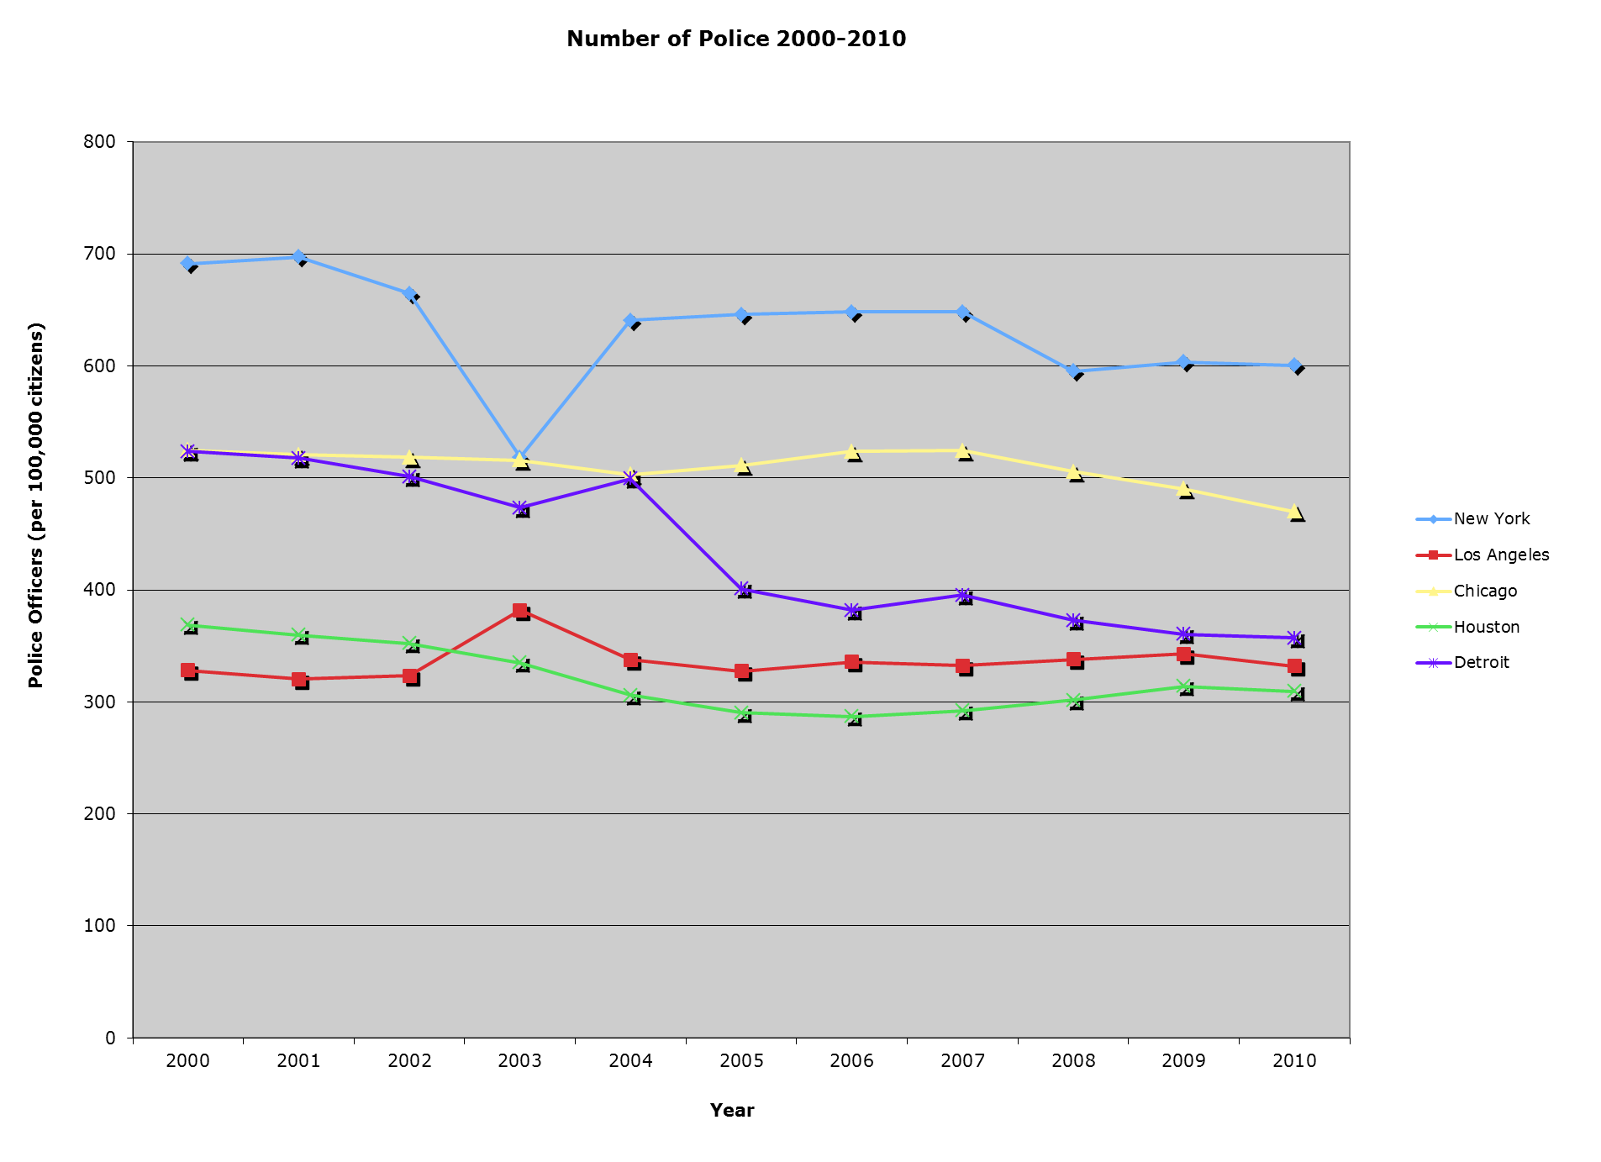

Slide 12
Does This Show a Clear Increase?
I decided to perform another Page test to determine whether or not the number of police has been steadily increasing as the crime has been decreasing
This time my response variable was the number of police (per 100,000 citizens in the city), my treatments were still the years, and my blocks were still the cities
I used the same alpha level, but this time I labeled the treatments as follows:
  2000=τ_{1 ,} 2001=τ_{2 …} 2010=τ₁₁
  I did this because I’m testing for an increase in officers as opposed to a decrease

Slide 13
Another Page Test!
Once again, here are my hypotheses:
H₀:τ₁= τ₂= …= τ₁₀= τ₁₁ vs. H₂: τ₁≤ τ₂≤ …≤ τ₁₀≤ τ₁₁ with at least one strict inequality
However, this time, here were my results:
L=1719, L*≈-3.356, p-value =0.9996
Therefore, not only do I fail to reject the null hypothesis, but since this p-value is so high I suspect that the number of police officers has actually been steadily decreasing in proportion to the population

Slide 14
The Relationship
So now that I’ve considered both of these variables separately, I’m finally ready to bring them together.
The first things I wanted to look at were some basic scatter charts with number of police on one axis and the number of crimes on the other
Here are those charts for each crime (keep in mind that, for the most part, the trendlines fit very poorly to the actual data):

Slide 19
Is There a Relationship?
As you can see from these charts, it is very unclear what the relationship, if there is one, is between the number of police officers and the crime rates from 2000-2010
I decided to perform a distribution-free test for independence based on signs, also known as the Kendall test
Once again, I used an alpha level of 0.05

Slide 20
Kendall Test
H₀:The number of law enforcement employees and the crime rate are independent of one another vs. H₁:They are not independent of one another
I then used R to determine the following values for each crime:
  Murder: z=-1.1474, p-value=0.2512, tau-estimate ≈-0.107
  Rape: z=0.1525, p-value=0.8788, tau-estimate ≈0.014
  Robbery: z=-0.1597, p-value=0.8731, tau-estimate ≈-0.015
  Assault: z=-0.3933, p-value=0.6897, tau-estimate ≈-0.037
Therefore, we do not reject any of the null hypotheses in favor of the alternative, meaning there is no significant relationship between the number of law enforcement employees and the crime rate

Slide 21
Conclusion
Does this mean that we could get rid of every single cop and the crime rate will not change at all? No.
The fact is, there are a variety of factors that have gone into the reduction of crime in these cities, and I simply believe, based on this data, that an increase in the police force is not one of them.
I think the main conclusion that I can draw from this data is that in cities like these where the police forces are already so massive, a small increase or decrease in police officers simply will not effect the rate of violent crime.

Slide 22
Sources
http://www.city-data.com/crime/
www.fbi.gov
http://www.biggestuscities.com/
http://bjs.ojp.usdoj.gov/
*See more detailed bibliography in the final paper

